Slide 1
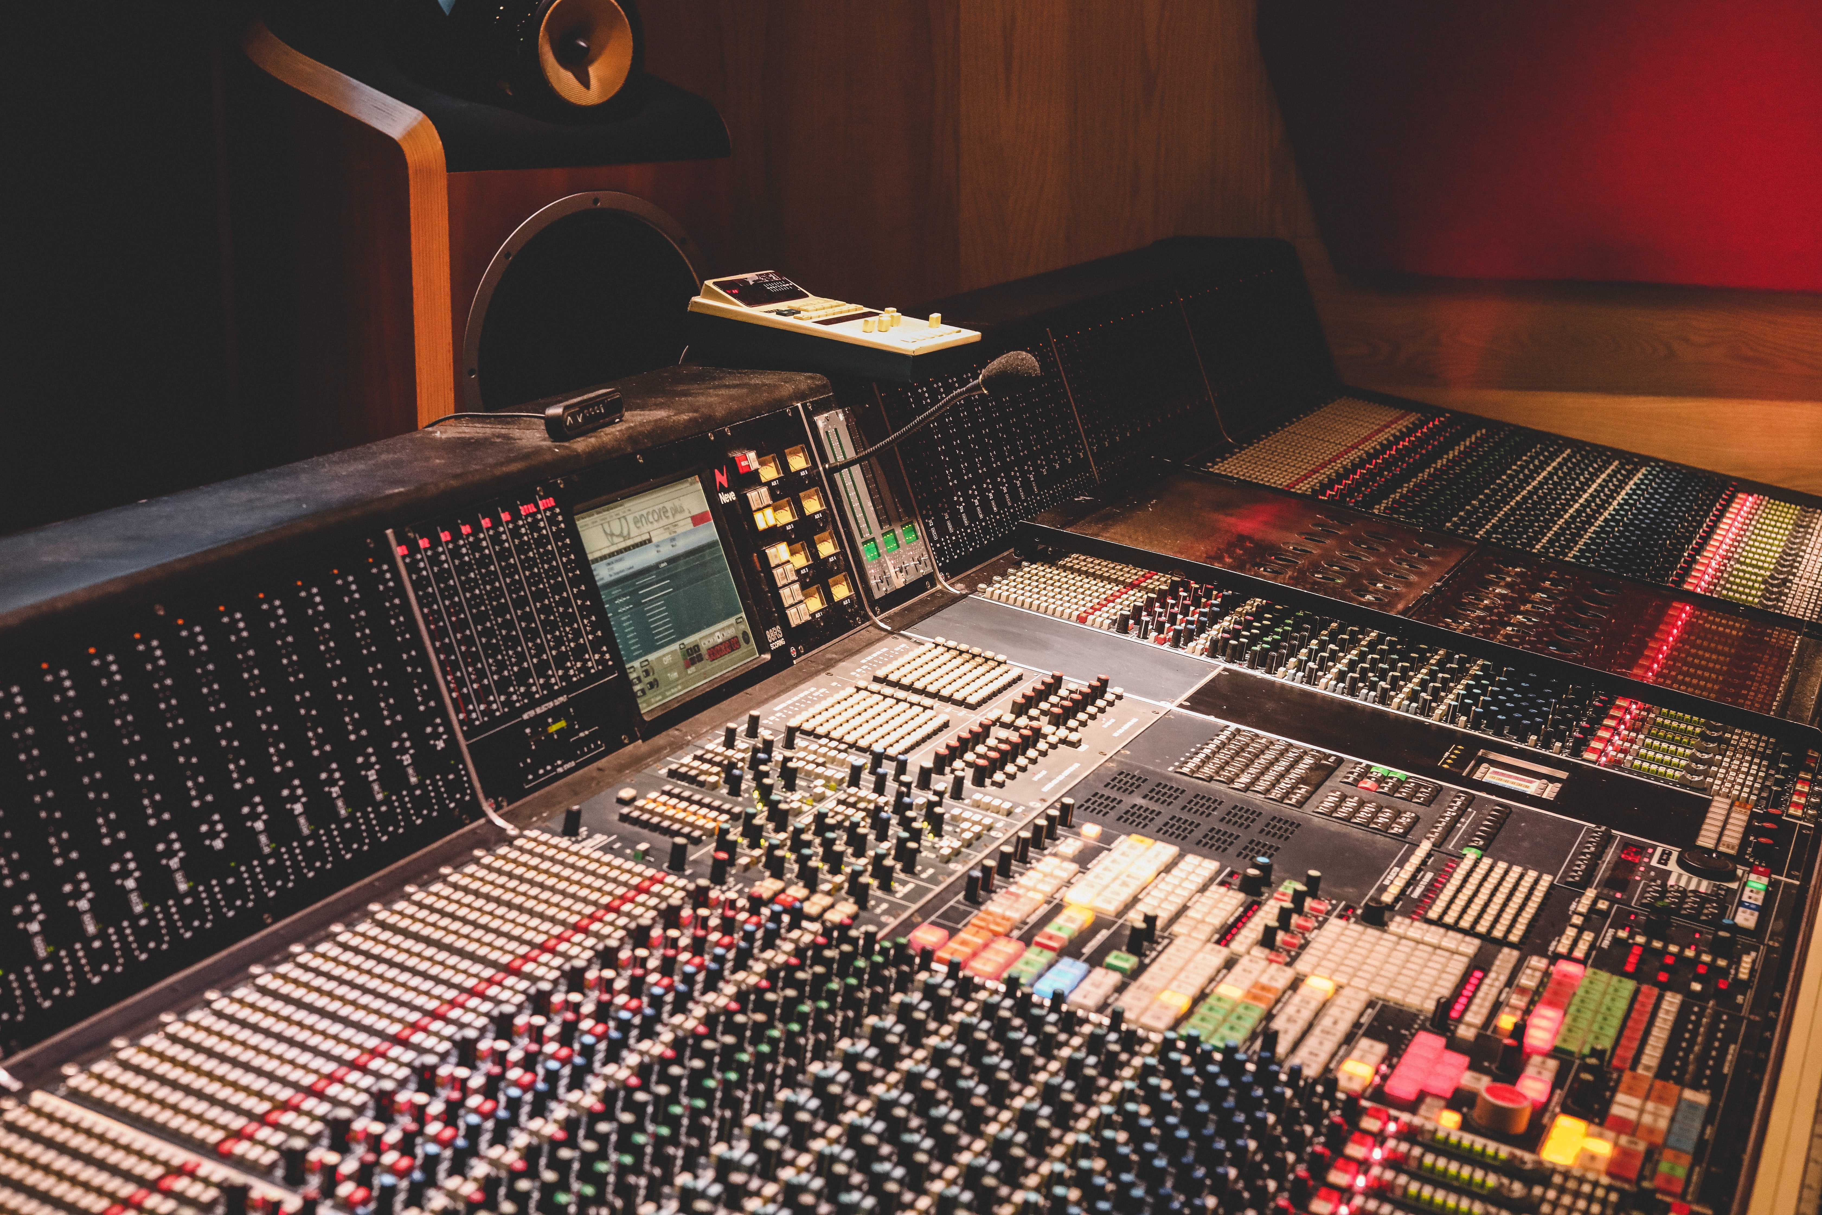

Top 3 Songs Musical Analysis
Photo by Marc Fanelli-Isla on Unsplash
‘s
BLAK
Notes:
© Copyright Showeet.com – Creative & Free PowerPoint Templates

Slide 2
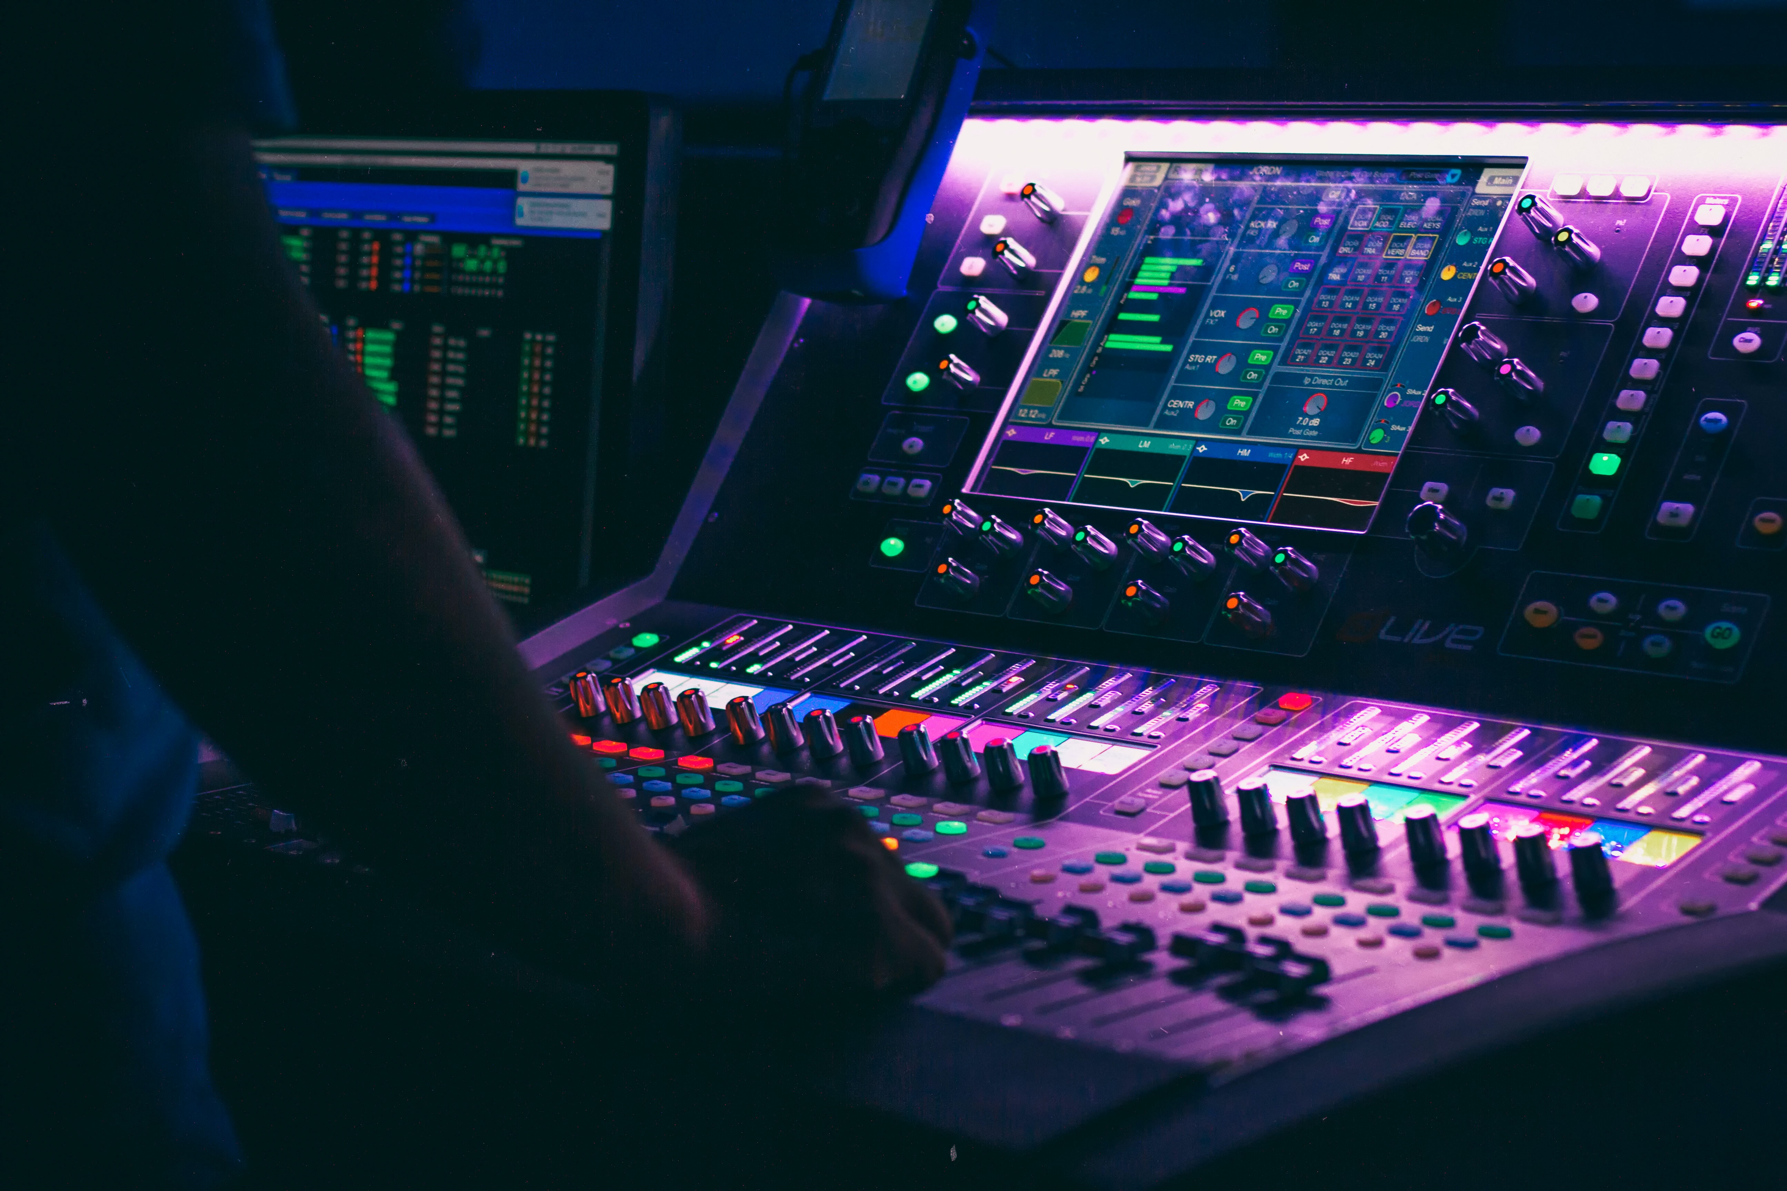
Roadmap
Intro and Question
Techniques Utilized
Shiny App
Commonalities Among the Best
Oddities
Acoustic Music 2011-2015
Future Directions
Conclusion
Photo by Denisse Leon on Unsplash
Notes:
© Copyright Showeet.com – Creative & Free PowerPoint Templates

Slide 3
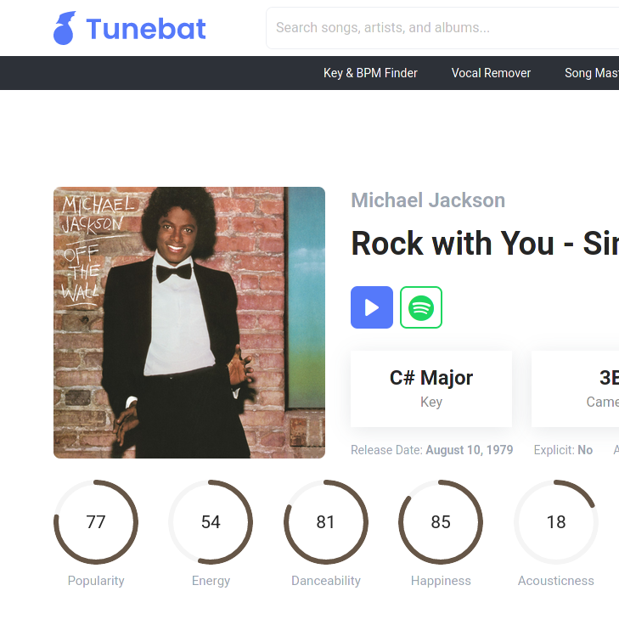
Intro & Question
Can we discern correlations between properties of songs & Top 3 Peak Rank on Billboard?
Can we discern correlations between properties of songs & Weeks Lasted on Billboard?
Notes:
© Copyright Showeet.com – Creative & Free PowerPoint Templates

Slide 4

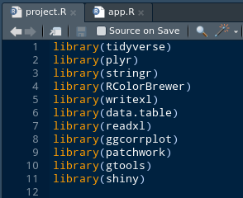
Techniques Used
Created a Shiny App, hosted on shinyapps.io.
Used various libraries:
Readxl, ggcorrplot, patchwork, gtools (for pipe-friendly stat functions)
BLAK
Notes:
© Copyright Showeet.com – Creative & Free PowerPoint Templates

Slide 5
Shiny URL
BLAK
Notes:
© Copyright Showeet.com – Creative & Free PowerPoint Templates

Slide 6
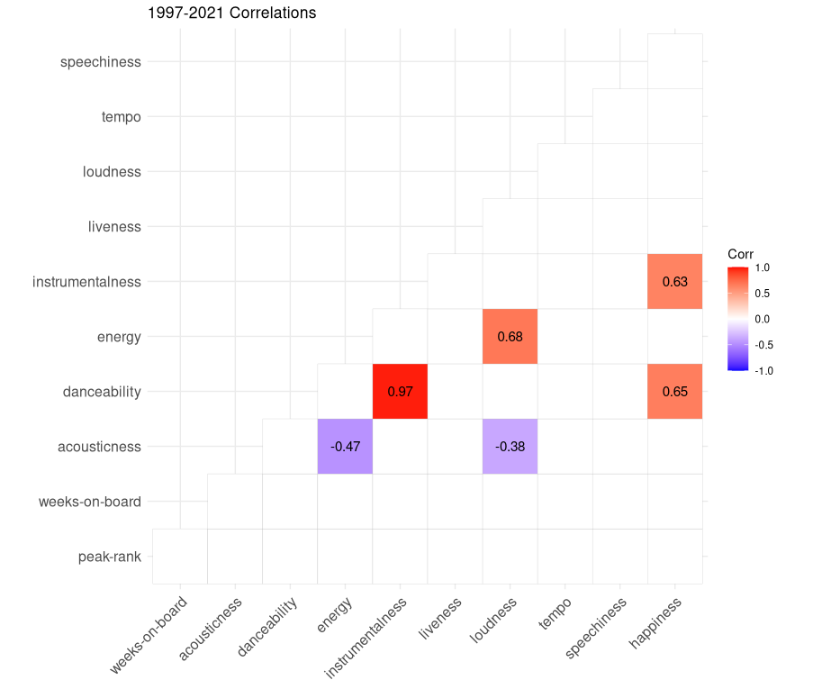
Commonalities
Correlation matrices were made for various song statistics, and non-significant correlations (based on p-value, Pearson, two-sided, reject if p<.3 )
Unfortunately, there was no clear correlation between data and peak rank (a theory on that later)
Notes:
© Copyright Showeet.com – Creative & Free PowerPoint Templates

Slide 7
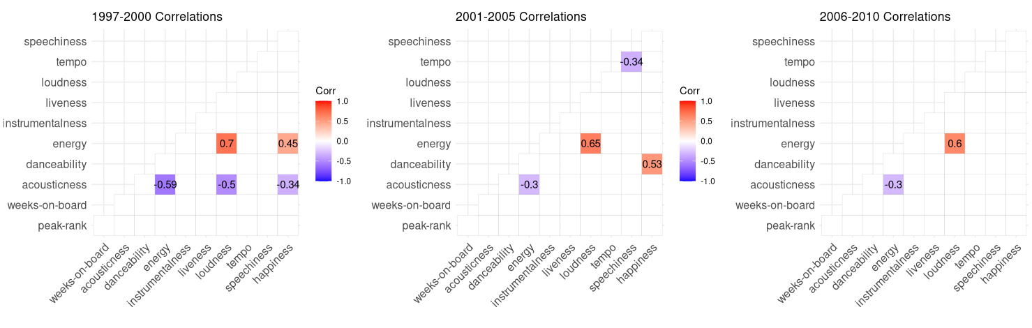
Commonalities 1997-2010
Notes:
© Copyright Showeet.com – Creative & Free PowerPoint Templates

Slide 8
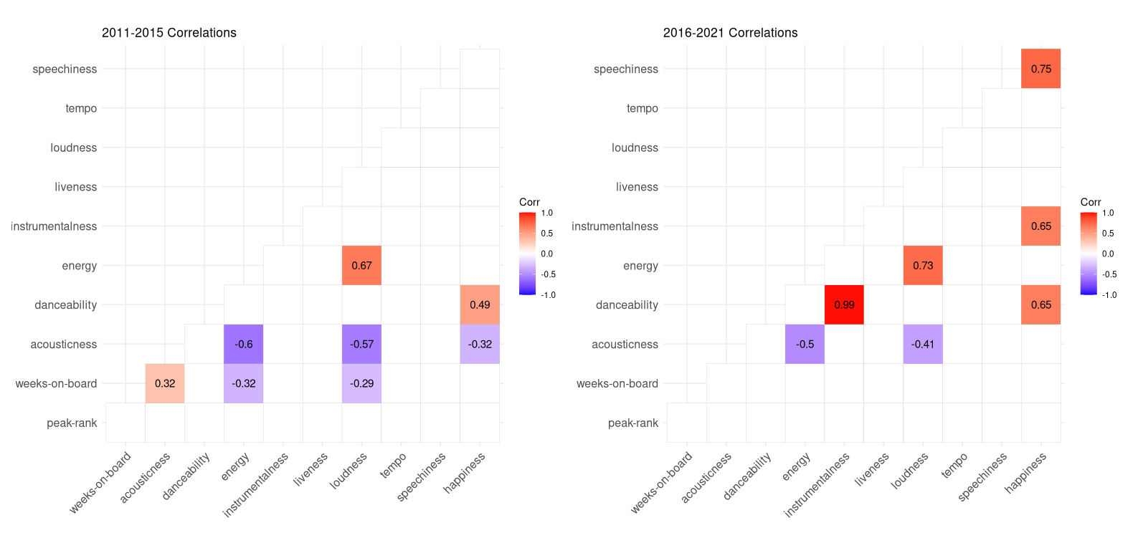
Commonalities 2011-2021

Slide 9
Oddities
Oddly, Acoustic songs slightly correlated to Weeks on Board in 2011-2015.
Popular Instumentals are extremely danceable nowadays
Next, we will investigate these acoustic songs more deeply.
Notes:
© Copyright Showeet.com – Creative & Free PowerPoint Templates

Slide 10
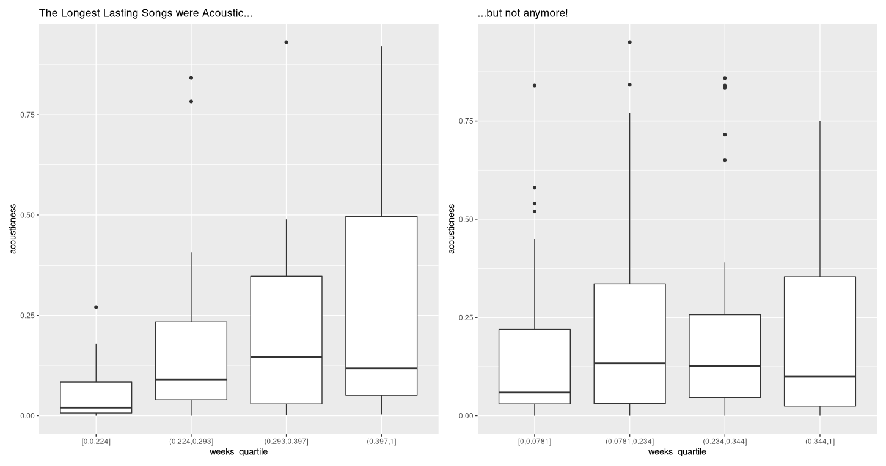
2011-2015 vs 2016-2021
Notes:
© Copyright Showeet.com – Creative & Free PowerPoint Templates

Slide 11

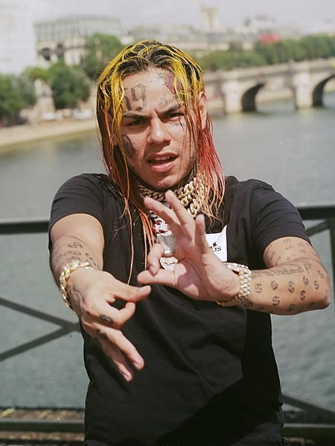
Conclusion
Photo by Harald Krichel on Wikimedia Commons
Two kinds of songs emerged as consistently within Billboard Top 3:
High-energy, (optionally) dancable, loud songs
Acoustic, low-energy, sad songs.
In 2011-2015, there was an unexpected increase in popularity of Acoustic songs.
Recently, danceable, happy, and speechy songs are becoming popular
BLAK
Photo by User: Vladimir on Wikimedia Commons
Notes:
© Copyright Showeet.com – Creative & Free PowerPoint Templates

Slide 12
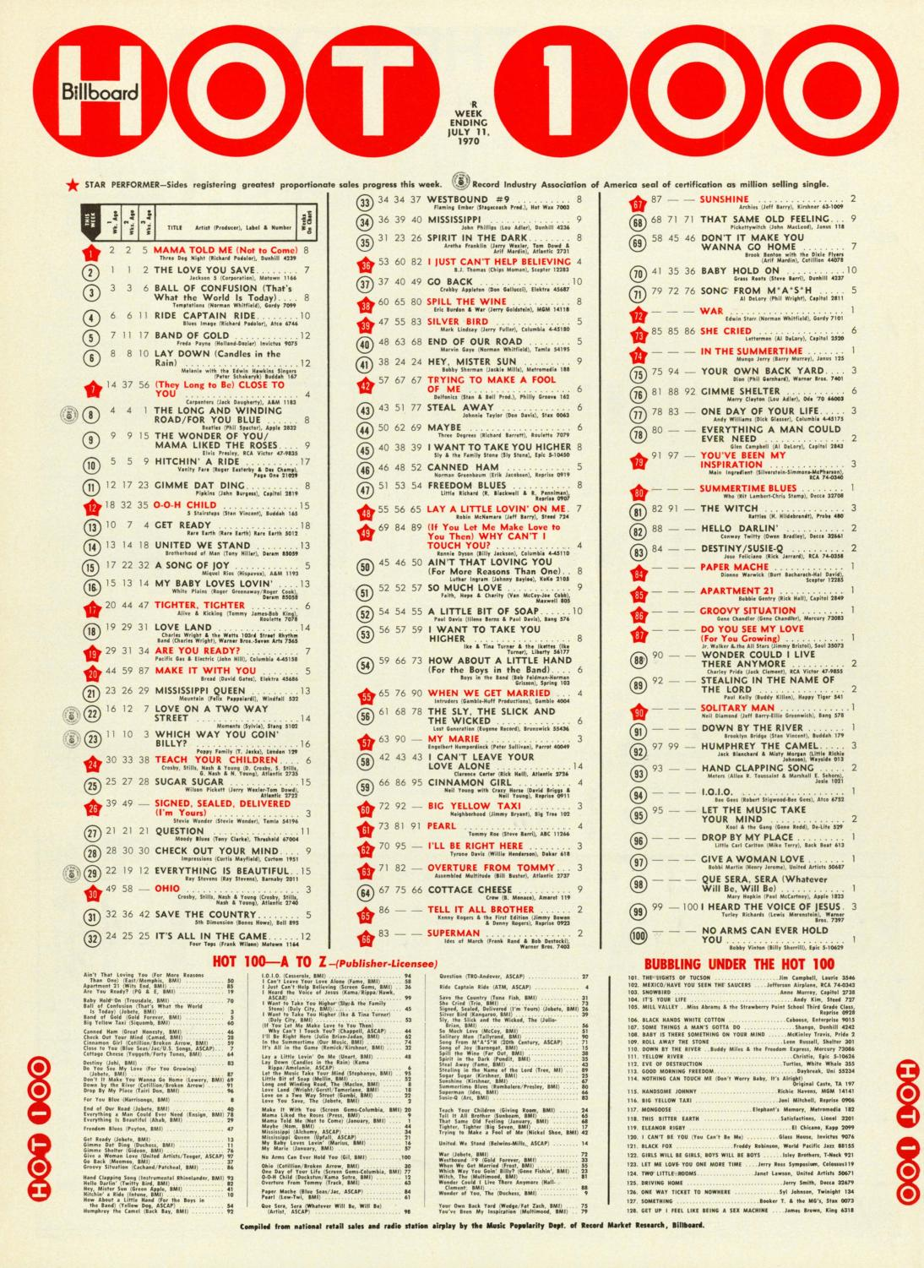
Future Directions
No good data on unpopular songs, songs that didn’t make the charts or songs that didn’t get above peak of 50.
More granularity in the data, more properties of the music to parse
Genre or Label-grouped Analysis
BLAK
Notes:
© Copyright Showeet.com – Creative & Free PowerPoint Templates

